Slide 1


CRIME IN NYC PRECINCTS
- Neil d’souza, Nikhil Kishore, Priya KHOKHER, SACHIN VERMA

Slide 2
INTRODUCTION
1 year in NYC
328 Murders
1120 Rapes
19500 Robberies
140000 Thefts

Slide 3
DATA
Data | Definition | Granularity
Crime Statistics^{[1]} | Data about Crime in NYC | By Precinct
NYC Precinct^{[2]} | NYC area divided according to Police Stations Jurisdiction | ShapeFile
Race, Income^{[3]} | Demographic data for NYC | Census Tract
Age, Gender^{[4]} | Demographic data | By Zip Code
Schools^{[5]} | Point Locations of Schools in NYC | By Zip Code
Notes:
We used 2010 data. As continuous data for all datasets was not available.

Slide 4
DATA MUNGING
Mismatch in geographical divisions of different data sets.
Precincts, Census Tracts, Zip Codes
ArcGIS, Python
Approaches
Intersection
Centroids and spatial join

Slide 5
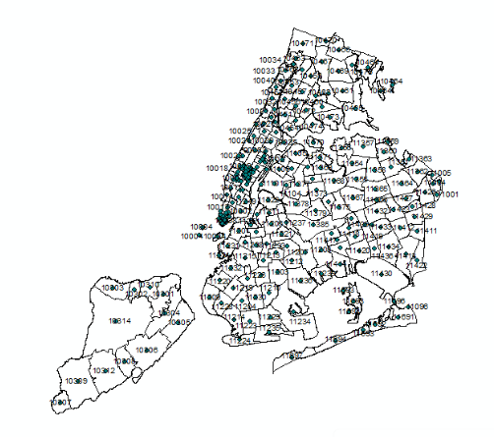
Zip Codes with centroids

Slide 6
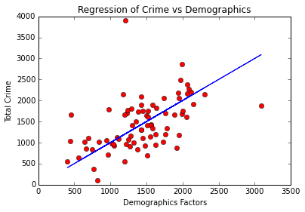
ANALYSIS
Multivariate regression
Low p-values
R-squared of 0.573 on validation set compared to 0.510 on training set.

Slide 7
ANALYSIS
Feature selection (forward-stepwise)
Total population, number of women, white people, Asians and Native Hawaiians
People falling under these categories need not be perpetrators of crime but also (and most probably) victims of crime.

Slide 8
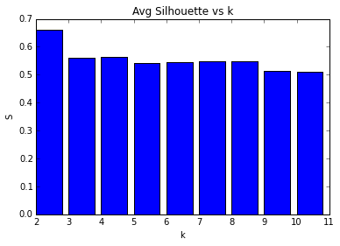
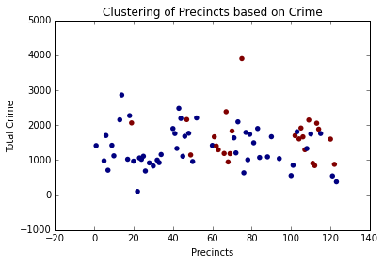
ANALYSIS
Outputs of K-means clustering:
No clear visual distinction

Slide 9
PRINCIPAL COMPONENT ANALYSIS
Names | Coefficients
Total Population | 1.03041301e-07
Number of Men | 2.42203284e-06
Number of Women | -8.75917207e-03
Whites | 7.31023197e-02
Blacks | 5.87278259e-01
American Indians | 2.18316170e-01
Asians | -1.22553177e-02
Native Hawaiians | -4.20917011e-01
Others | -2.34135769e-01
Men below 25 | 6.04695847e-01
Men between 25 -70 | -6.36243539e-02
Women below 25 | -1.12106425e-02
Women between 25-70 | -4.75588920e-03
Mean Income | 5.21946758e-03
Median Income | -2.74243175e-04
Number of Schools | 3.73161668e-05
Highest
impact

Slide 10
CONCLUSION
Demographic factors play a role.
Higher the minority population, greater the crime.
K-means clustering was inconclusive.

Slide 11
DATA SOURCES
[1] “Crime Statistics⁴” NYPD (2010), available at http://www.nyc.gov/html/nypd/html/analysis_and_planning/historical_nyc_crime_data.shtml
[2] “NYC Precinct shapefile¹”,(2010), available at http://www.nyc.gov/html/dcp/download/bytes/nypp_15c.zip
[3] “Race, Income²”,Census Data (2010), available at http://factfinder.census.gov/faces/nav/jsf/pages/index.xhtml
[4] “Age, Gender³”, Census Data(2010), available at http://factfinder.census.gov/faces/nav/jsf/pages/index.xhtml
[5] “Number of Schools⁵” New York Op10ern Data (2010), available at https://data.cityofnewyork.us/Education/School-Point-Locations/jfju-ynrr

